Slide 1
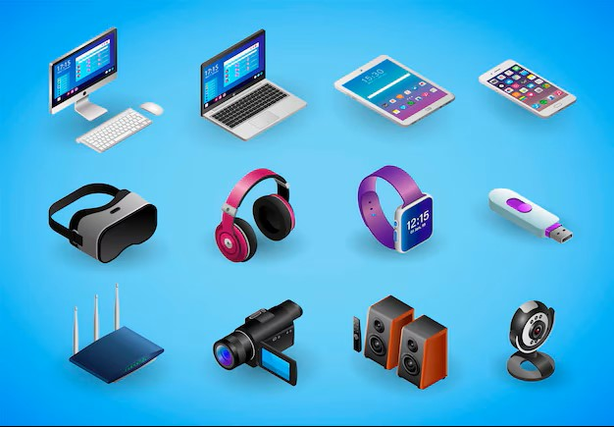
AFRITECH ELECTRONICS LTD

Slide 2
Introduction
In today’s hyper-connected world, a brand’s reputation is largely influenced by online dialogue. Social media monitoring has evolved from a supportive function to a critical necessity. Detecting negative sentiment early, responding swiftly to public concerns, and engaging authentically with audiences empower brands to mitigate risks before they escalate.
Leveraging advanced technologies such as sentiment analysis, real-time monitoring systems, and well-structured crisis response protocols enables organizations to strategically shape public perception, react quickly to emerging issues. Strengthen customer engagement and loyalty, Preserve brand integrity and trust in a competitive environment
Ultimately, investing in intelligent social media oversight is not merely a defense mechanism—it is a strategic asset for building sustainable brand equity.

Slide 3

Introduction

Slide 4
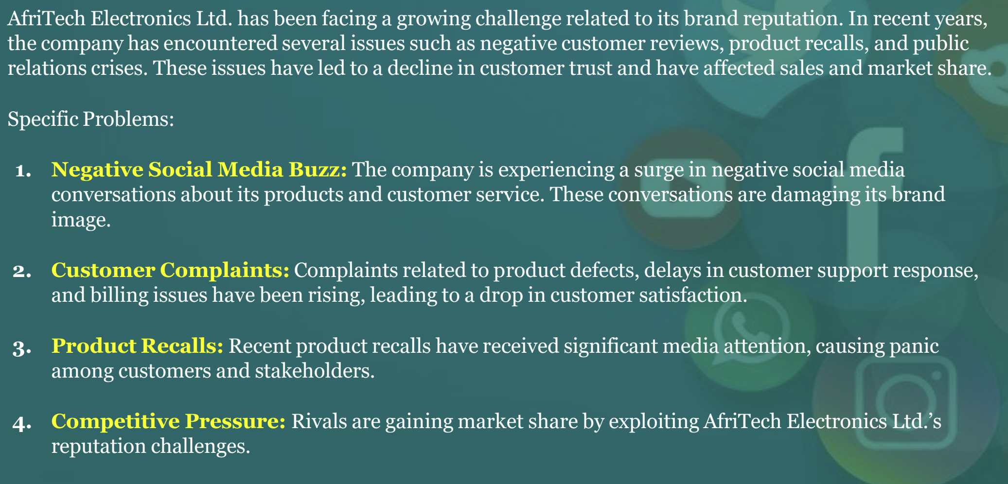
Business Problem

Slide 5
Summary of Steps-
Data Cleaning
Data Validation
Exploratory Data Analysis
Uploading Data in Database
Data Exploration in SQL
Loading of Data to PowerBI
Data Visualization
Creating DashBoard

Slide 6
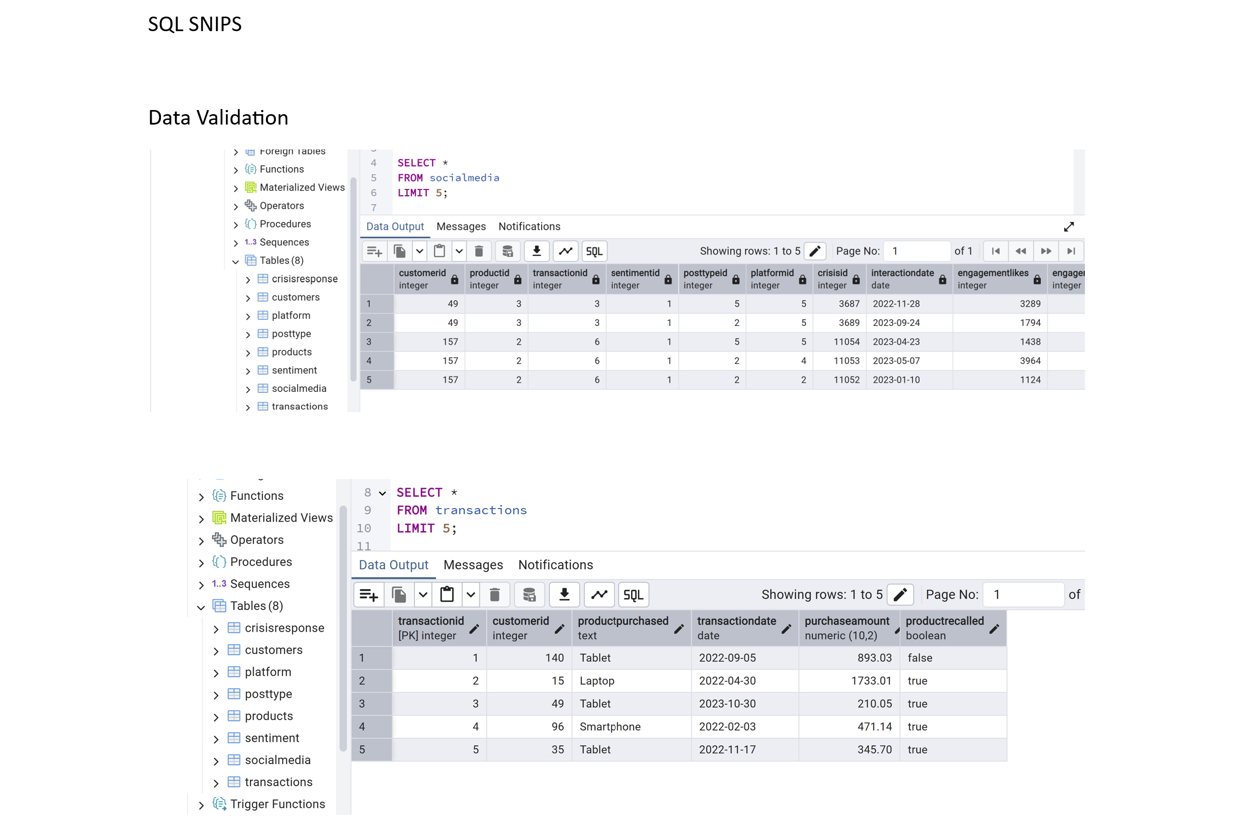

Slide 7
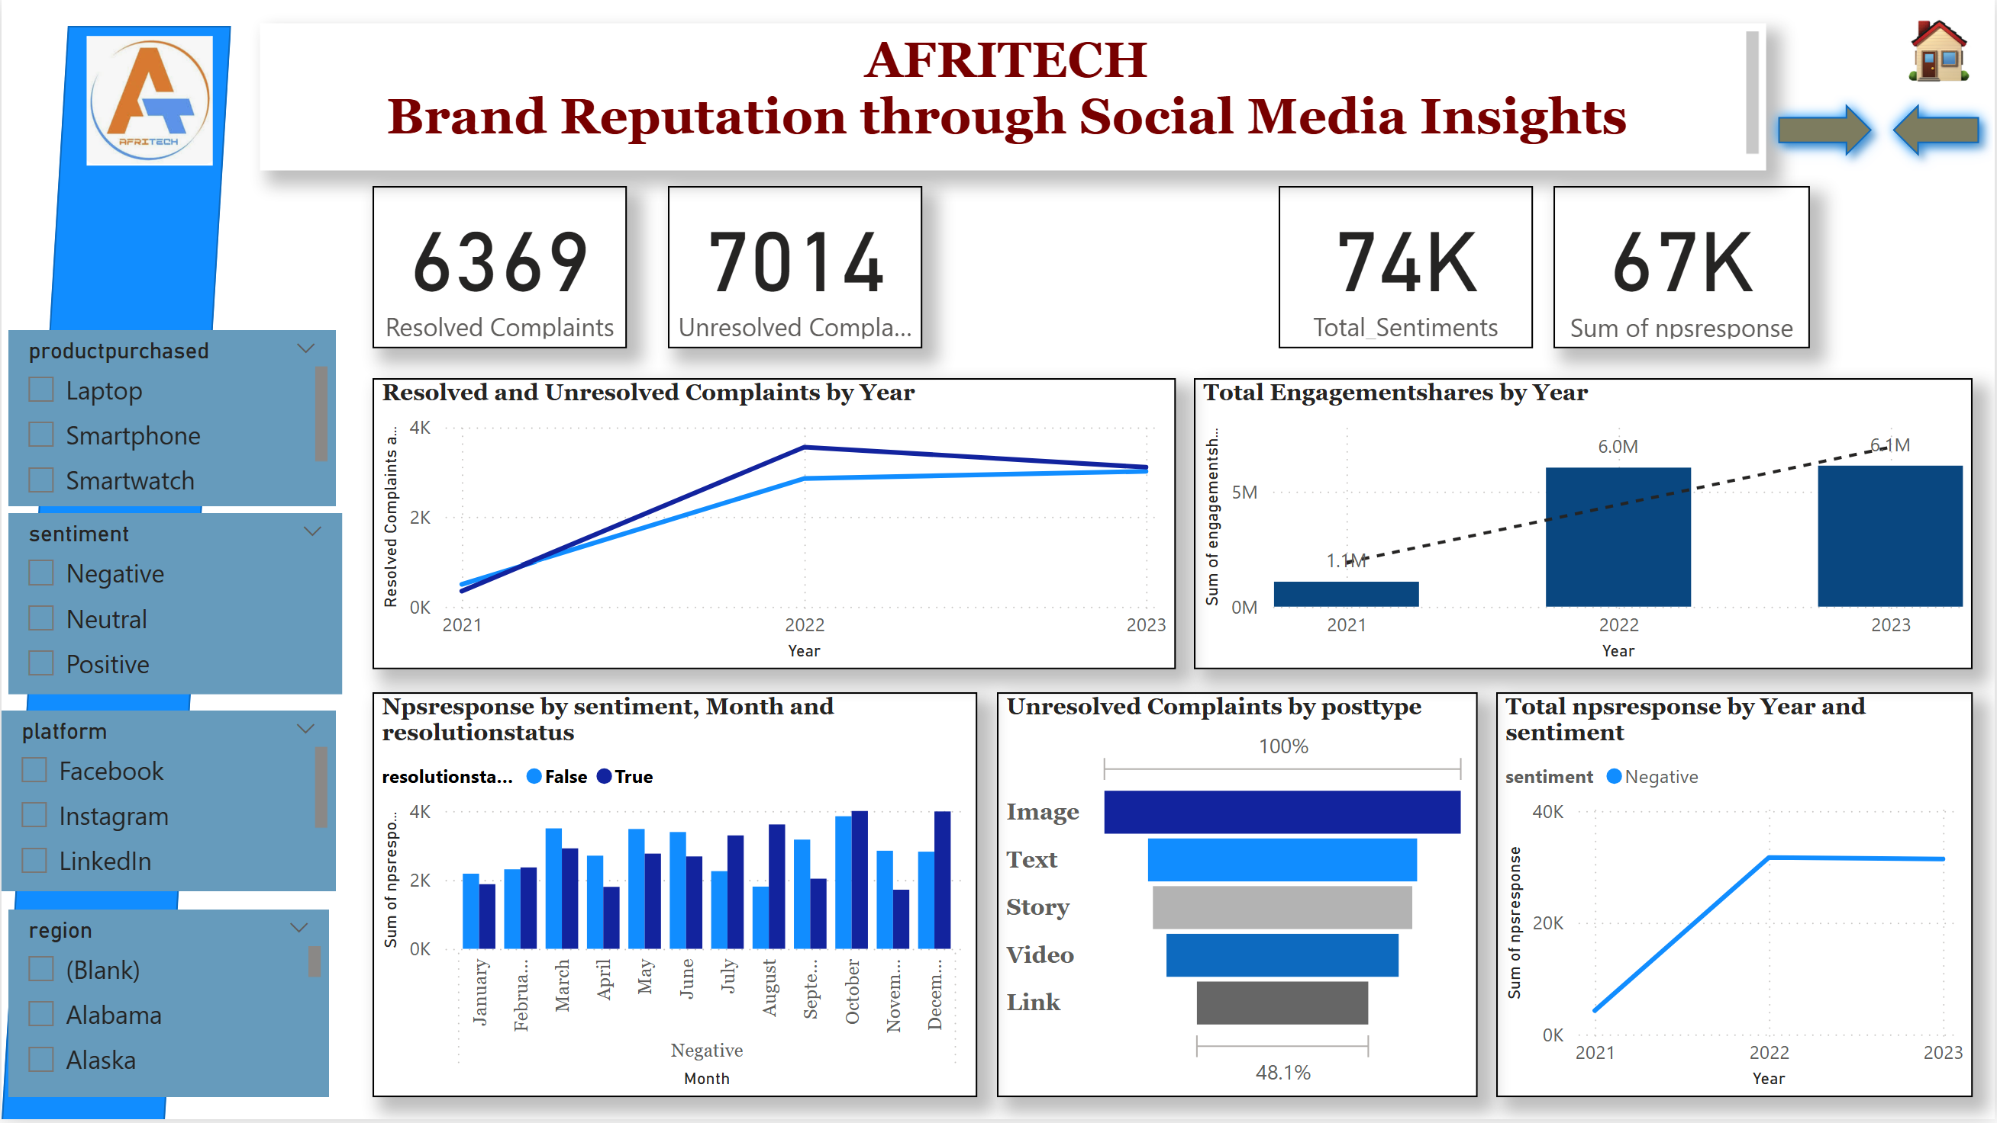

Slide 8
Crisis- Enhancing Brand Reputation
Rapid Amplification of Negative Sentiment
Social media acts as an echo chamber where complaints, misinformation, and negative feedback can spread within minutes. A single dissatisfied post has the potential to go viral before the brand has a chance to assess or respond.
Delayed or Ineffective Response
In the absence of real-time monitoring tools and well-defined crisis protocols, brand responses may be slow, misaligned, or tone-deaf. Even short delays can lead to mistrust and leave room for rumors or misinformation to gain traction.

Slide 9
Impact of Crisis on Brand Reputation
Erosion of Customer Trust Failure to respond effectively to public concerns sends a message of indifference, undermining customer confidence and weakening long-term loyalty.
Lasting Reputational Harm Poor crisis management can leave a permanent digital footprint. Viral posts, screenshots, and media coverage continue to shape public perception long after the incident.
Financial and Strategic Consequences Widespread negative sentiment can lead to customer attrition, reduced revenue, damage to investor confidence, and the potential loss of key business partnerships.

Slide 10
Crisis management Challenges and Impact Brand Reputation
Challenge | Consequence
Lack of a structured crisis response plan | Disorganized internal efforts and delayed reaction times
Absence of real-time alert systems | Issues intensify without timely intervention
Ineffective cross-team coordination | Inconsistent messaging that undermines public trust

Slide 11
Social Media-
Challenges in Social Media: - Slow reaction to rapidly spreading complaints or negative content - Failure to capture brand mentions due to indirect tagging or spelling variations - Difficulty detecting early signs of negative sentiment or reputational risks Impact on Brand: - Negative public reactions may intensify before the brand has a chance to respond. - The brand risks losing control of its public image and message. - Perceived as out of touch with customer concerns and evolving market sentiment. Investing in intelligent social media supervision goes beyond defense—it acts as a strategic tool for nurturing lasting brand value and credibility.

Slide 12
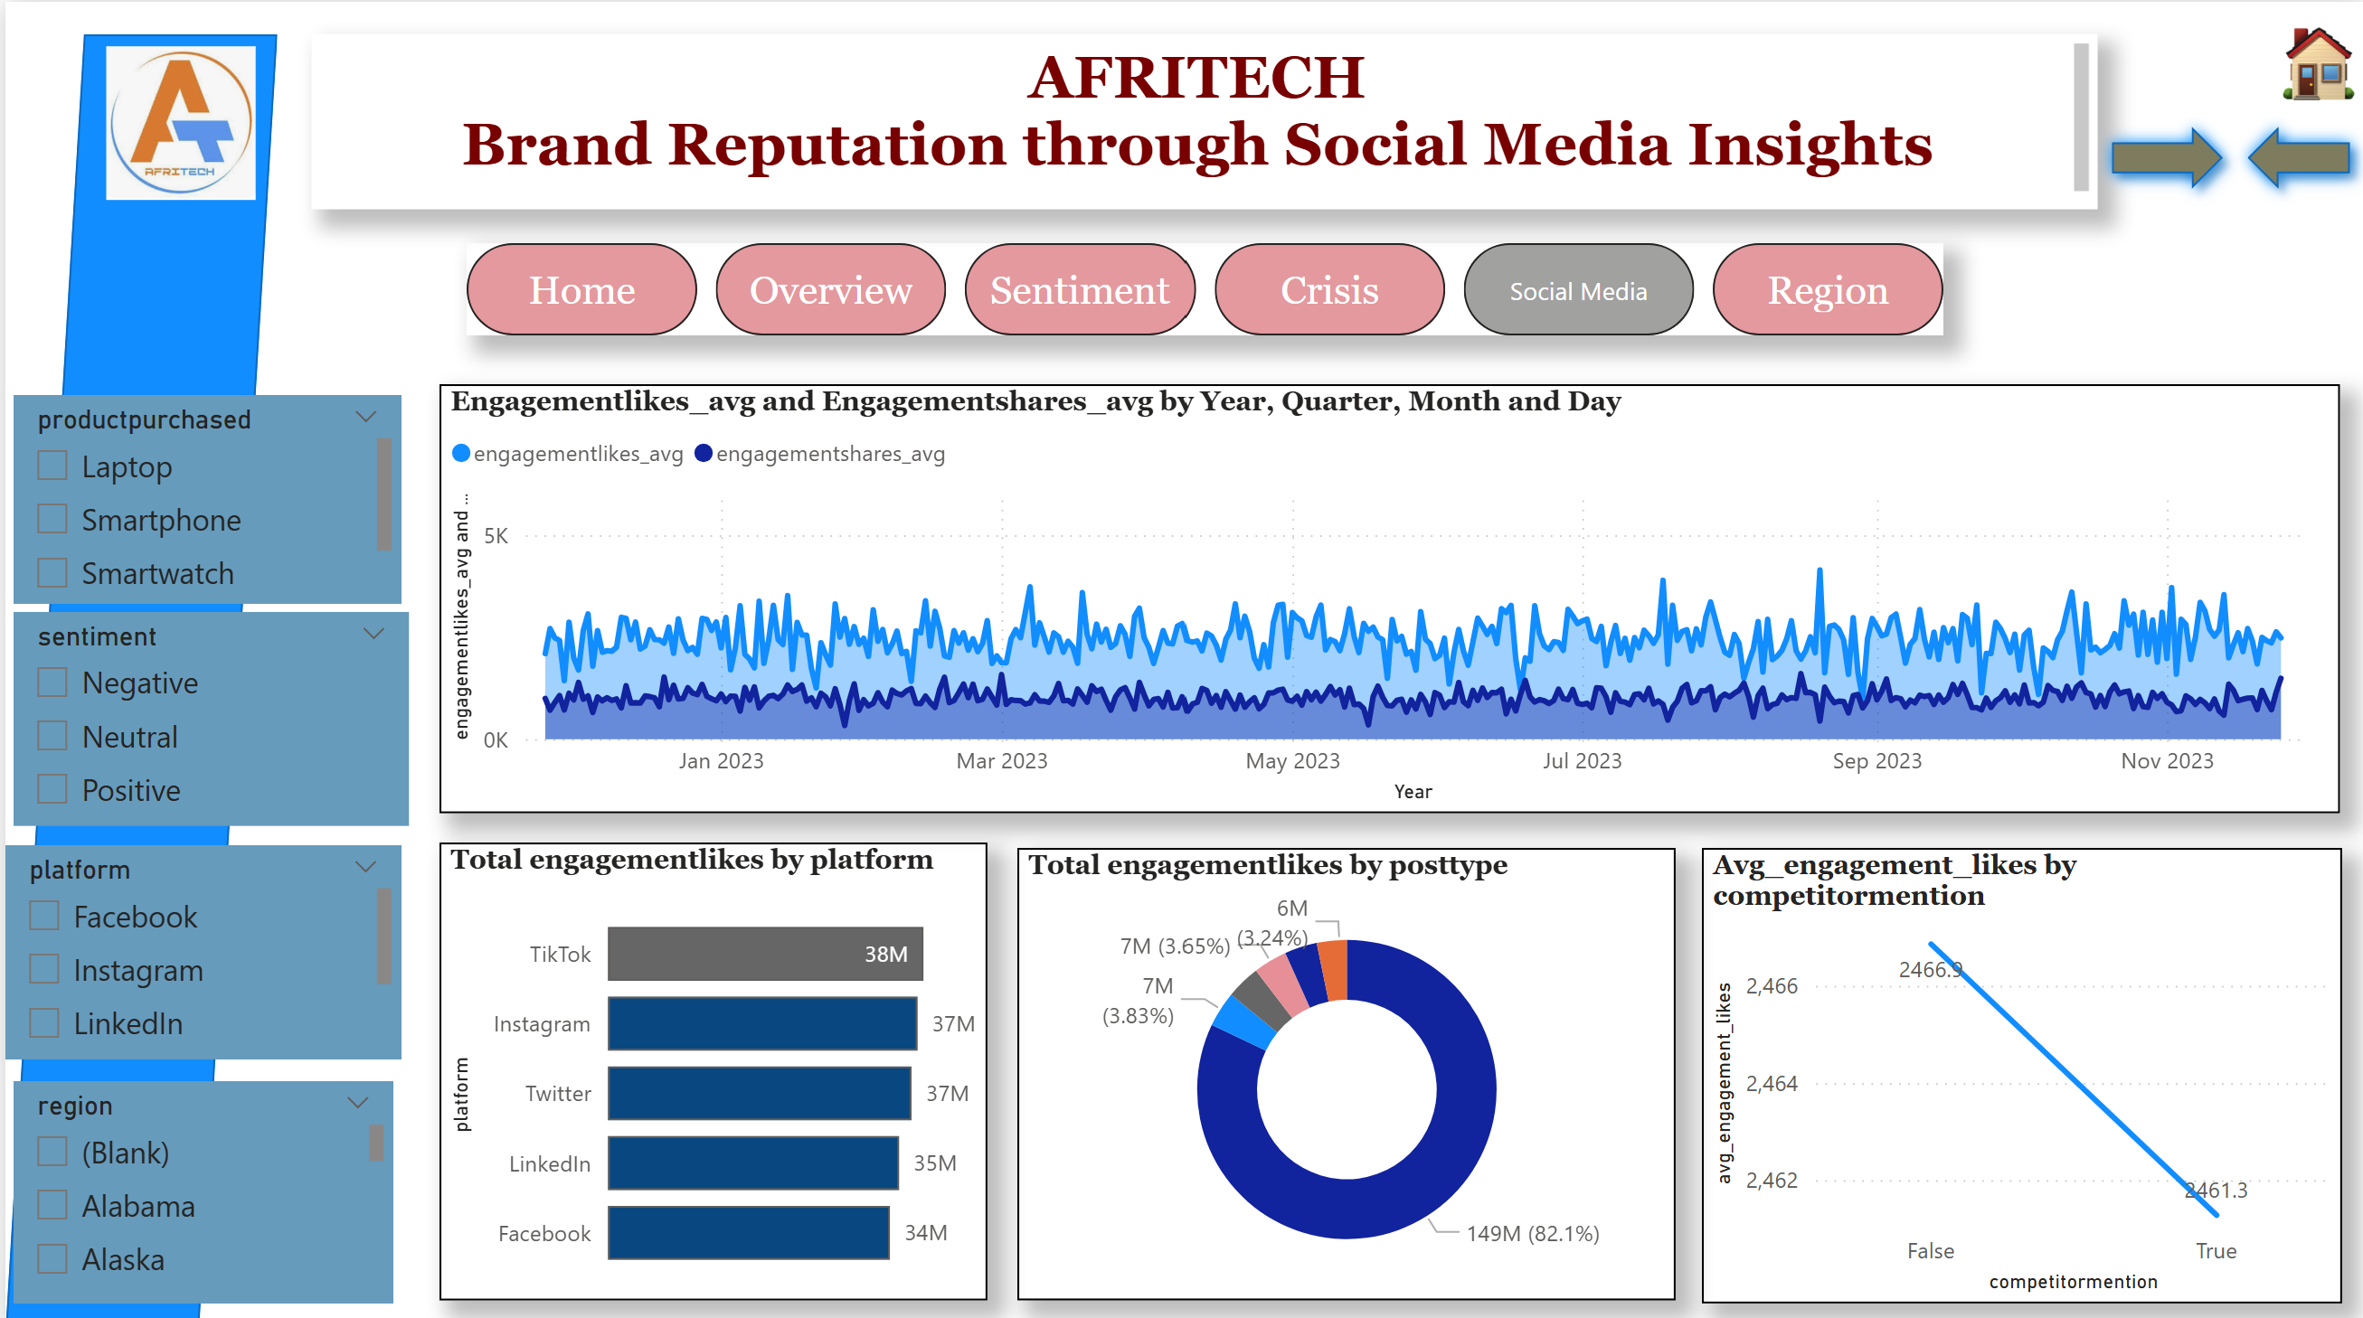

Slide 13
Social Media Challenges and Impact Brand Reputation
Challenges
Slow reaction to rapidly spreading complaints or negative content
Failure to capture brand mentions due to indirect tagging or spelling variations
Difficulty detecting early signs of negative sentiment or reputational risks
Impact on Brand
Negative public reactions may intensify before the brand has a chance to respond
The brand risks losing control of its public image and message
Perceived as out of touch with customer concerns and evolving market sentiment.

Slide 14
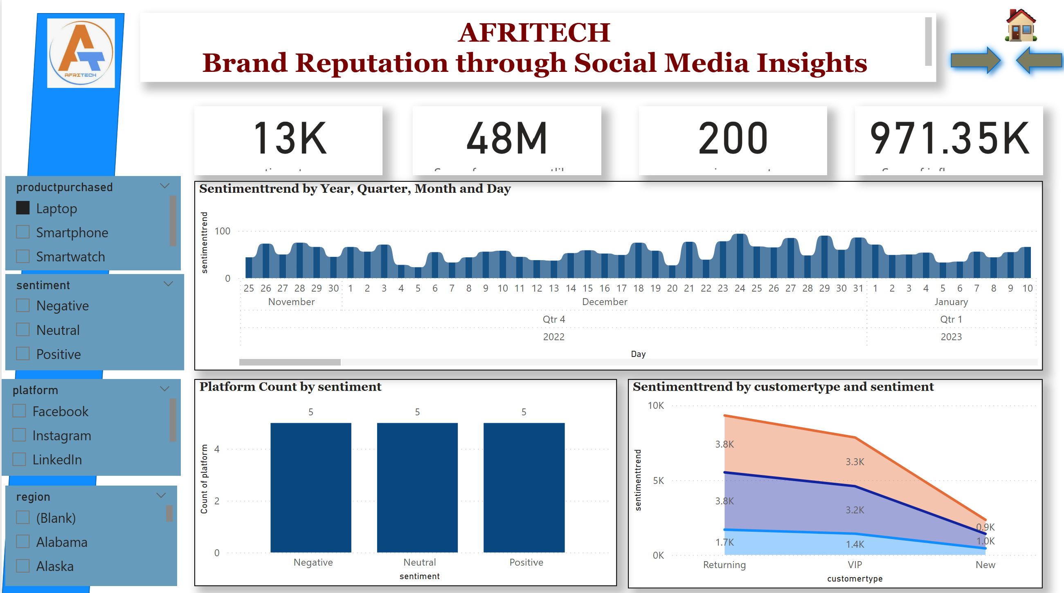

Slide 15
Sentiment Challenges and Impact Brand Reputation
Risk | Impact
Misreading sarcasm/slang/emojis | False positivity or false alarms
One-size-fits-all language models | Ignoring platform tone (Twitter vs LinkedIn)
No sentiment trend tracking | Missed mood shifts before major issues arise

Slide 16
Recommendations
Deploy AI-based monitoring tools with NLP capabilities
Build a real-time dashboard for mentions, sentiment, and influencer spikes
Create a data-driven crisis response framework
Train ML models on brand-specific tone and language patterns

Slide 17
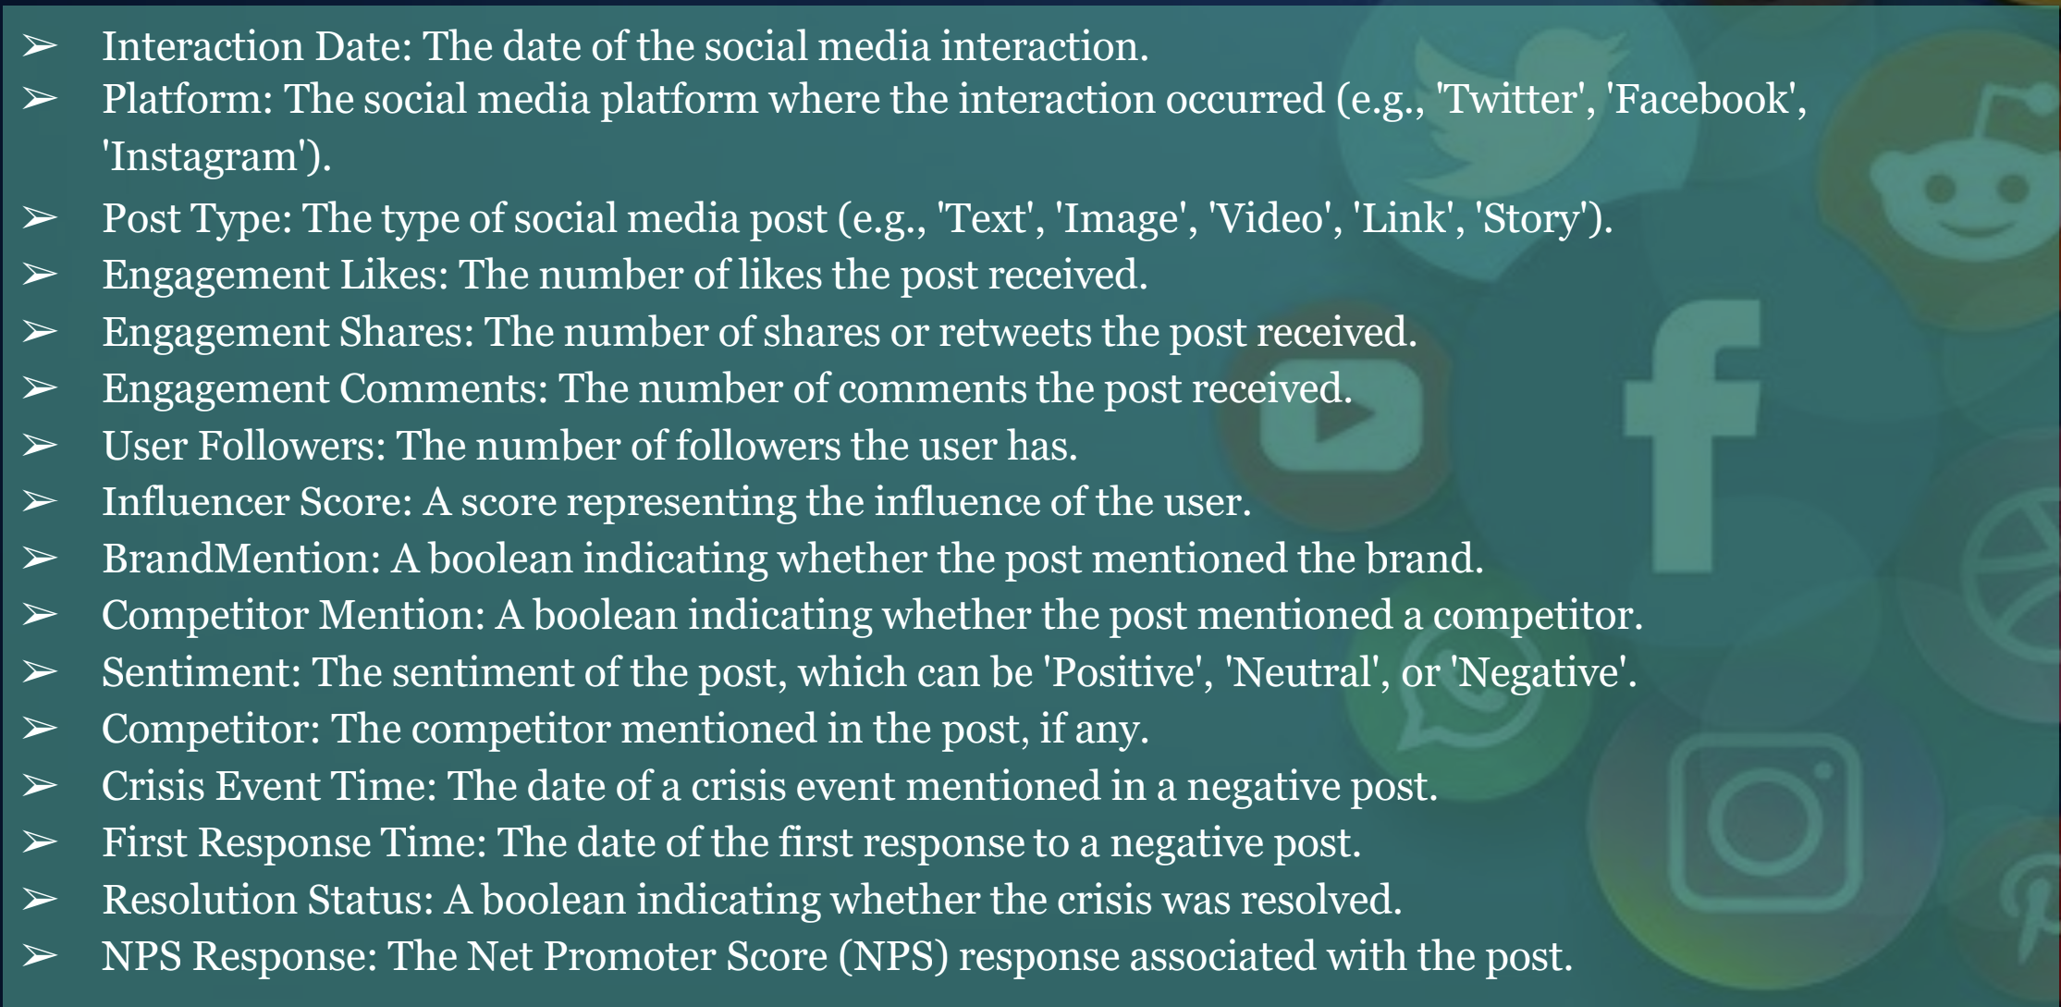
Data Dictionary

Slide 18
Conclusion
In today’s digital landscape, social media is both a powerful opportunity and a potential risk for brand reputation. The speed at which negative content can spread, combined with the public’s demand for timely and authentic responses, means that brands must be more vigilant than ever.
Challenges such as delayed responses, inconsistent messaging, and the inability to detect sentiment trends in real time can severely undermine customer trust and brand integrity. When mishandled, social media crises don’t just fade—they leave a lasting digital trail that can impact customer loyalty, revenue, and stakeholder confidence.
To safeguard and strengthen reputation, brands must invest in proactive monitoring, real-time analytics, and coordinated communication strategies. In doing so, they not only mitigate risk but also position themselves as transparent, responsive, and customer-focused leaders in their industry.

Slide 19
Thank you…… By Faith Ejele

